Slide 1
News and media training
By Wordwise Communications

Slide 2
TODAY’S AGENDA
Understanding how the media operates – electronic and print
Realistic expectations
What is news?
The personal approach
Basic writing skills
The Famous Five
Preparing for the interview
No need to be nervous

Slide 3
FIRST THINGS FIRST
1. Call the media outlet and establish deadlines
2. Better still, if it’s the local newspaper, drop in
3. Ask who you should send the contribution to – editor, news editor, reporter

Slide 4
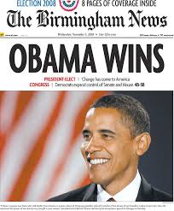
Is it newsworthy?
How to tell

Slide 5
News maths:
A bank teller + a holiday = not news
A bank teller + a holiday + missing $10,000 = news
A person + a car = not news
A person + a car + 200kph = news
An academic + research = not news
An academic + research + ebola vaccination found = news

Slide 6
Is it new?
Is it unusual?
Is it interesting or significant?
Is it about people?

Slide 7
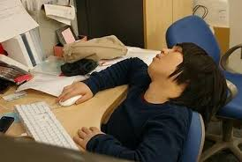
BORING?
CAN STILL
BE
INTERESTING

Slide 8
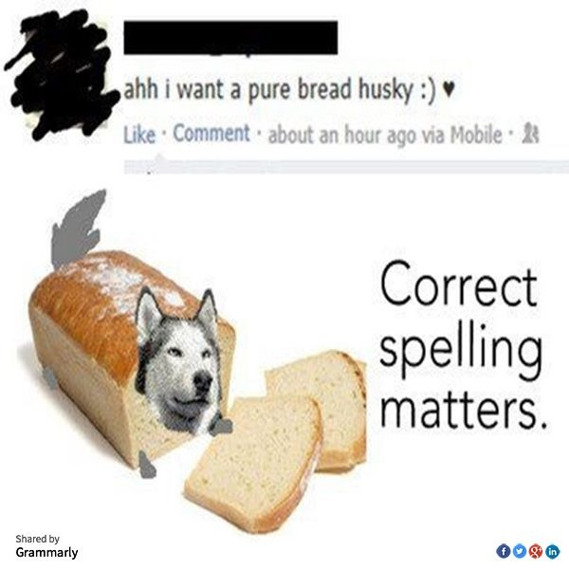
SPELLING AND
GRAMMAR
MATTERS

Slide 9
KISS
Who What When How Why
Past tense for indirect quote
Present tense for direct quote
Intro no more than 20 words

Slide 10
DOWN TO BUSINESS
Write down your key messages –
Use the Famous Five – who, what, where, when, how
The most interesting fact will be the introduction – NOT the date!
Build your story around your key messages – it should flow as if you’re telling someone about it
Keep it to one page
Do you have a photo?
Read over it, read over it, read over it and do it again

Slide 11
OPINION
VERSUS
FACT

Slide 12
BEWARE – IT ISN’T ALWAYS FAIR
Never trust a journalist
Never say anything “off the record”
When you are a guest speaker, don’t say anything you don’t want made public
If you feel a journalist hasn’t understood, offer to run through an issue again
If you have been misquoted, call the journalist and politely point this out

Slide 13
THE INTERVIEW
Know your subject
Write down your key messages
Take a few deep breaths
Journalists don’t bite
Answer and then shut up
Remember if something is off topic – say so
Pull back with: “Good question but …” or “I really want to emphasise …”

Slide 14
ONE MORE THING…
The media outlet needs you! Communities matter and community news is their job!

